Slide 1


A First Person Shooter Developed By

Slide 2
TNAH ENGINE
ZOOM was developed on the TNAH Engine
Efficiency and Reusability were at the forefront throughout development
Follows the requirements outlined in the Assignment 2 summary

Slide 3
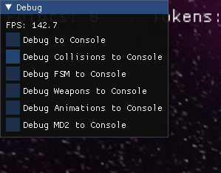
Engine Features
MVC Design
GameAssetFactory with game assets player, enemy, static and token
Lua Game Data and Game Objects
Rendering
Windows
AI (with lua)
AI Messaging
FBX and MD2 Models
Key Frame Animations
Menu
Input mapping
Heightmap Terrain
Collisions
Difficulties
Debugger

Slide 4
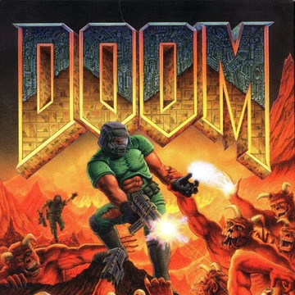

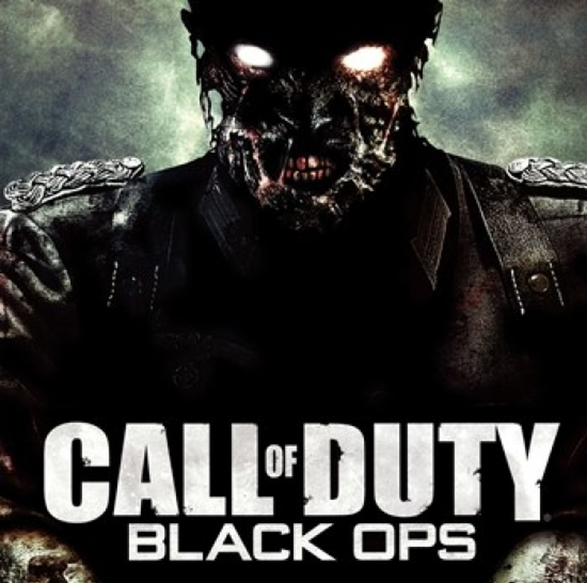
Fast and Frenetic Gameplay
Enjoyable Movement
Solid Shooting
Plenty of Enemies
Inspirators

Slide 5
Story Of ZOOM
“ZOOM takes place on a small but dangerous moon that has mysteriously appeared in the solar system, not too far from the Earth’s moon. The people of Earth grow increasingly anxious and suspicious of this new moon, but they continue to live out their everyday lives. A few days after the moon’s arrival, Demon’s start appearing around the globe, attacking civilians, and claiming Earth as property of the underworld. In retaliation to the attack on Earth by the Demons, the United Nations enlist the help of ZOOM Girl, a biological superhuman who they see as humanity’s only hope of eradicating the demonic spawn. ZOOM Girl is quickly sent to the Demon moon now known as the “Neighbour in the Night Sky” with a simple mission – kill as many Demons as you possibly can.”

Slide 6
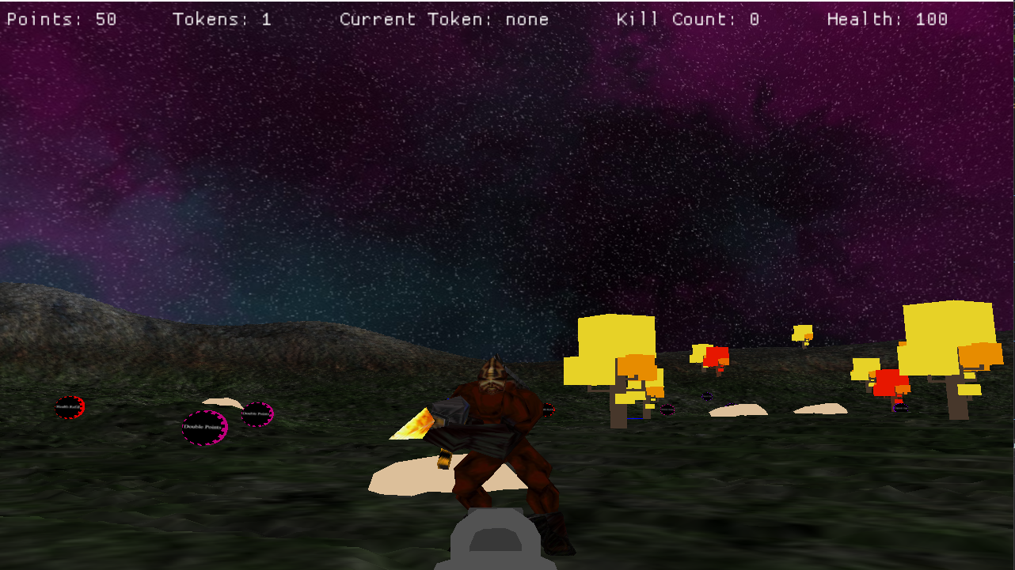
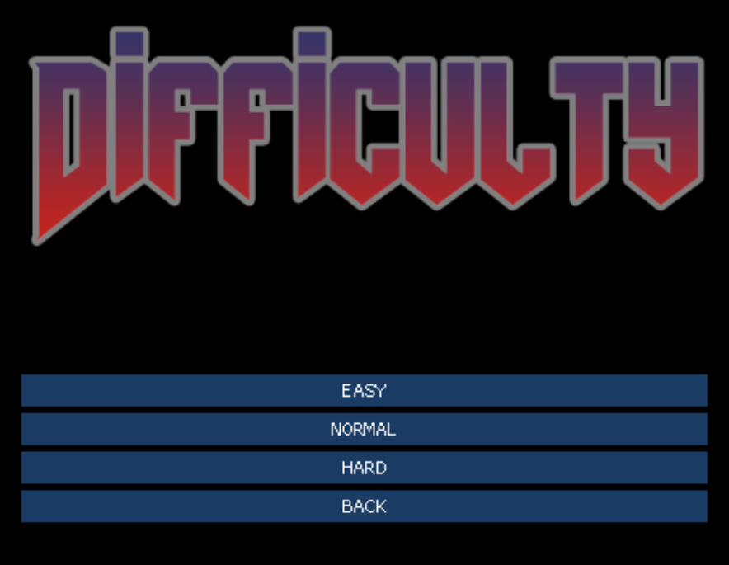
Game Summary
Survive as long as you can
Get a high score
Kill everything
Collect Tokens to make you stronger, faster etc

Slide 7
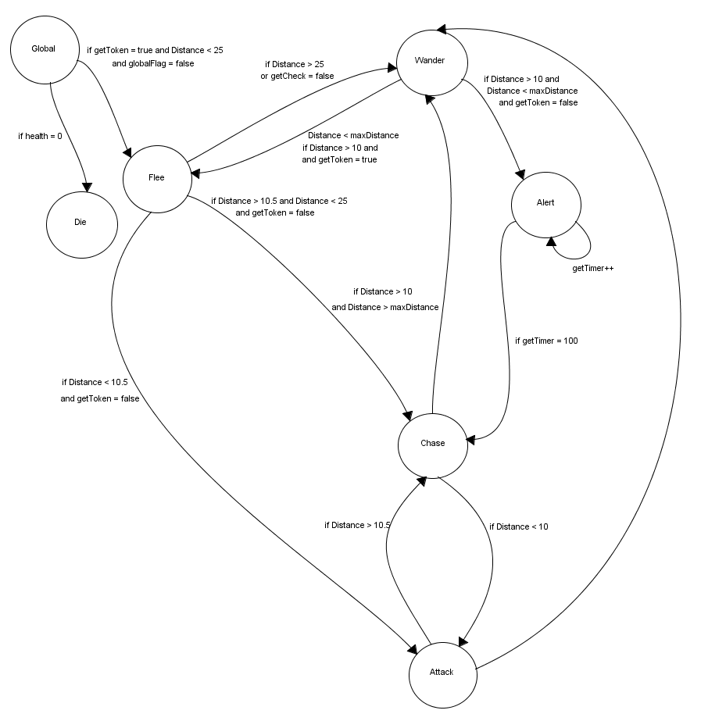
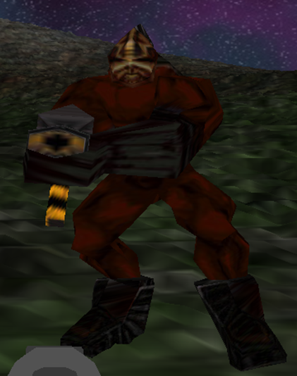
Artificial Intelligence

Slide 8
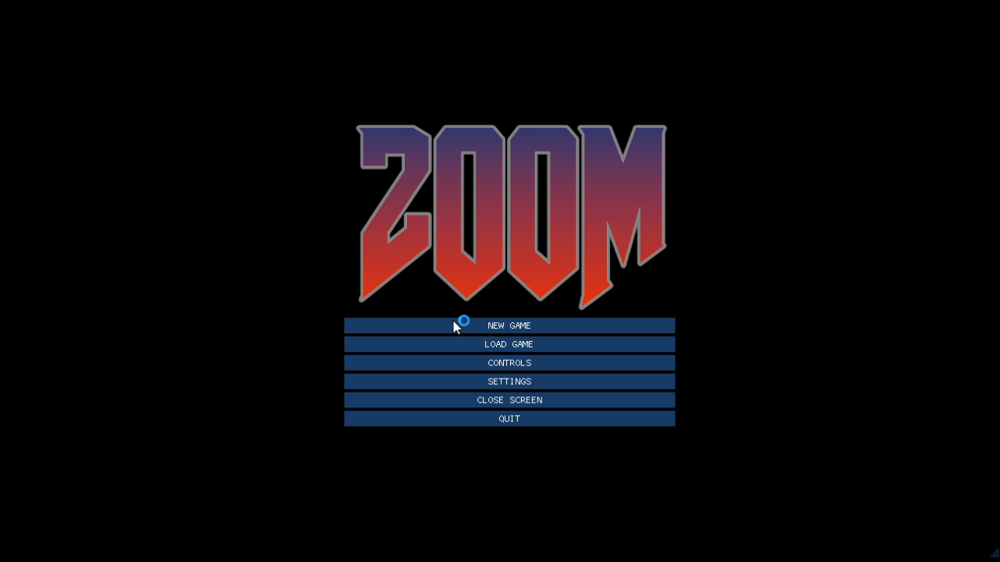
Artificial Intelligence

Slide 9
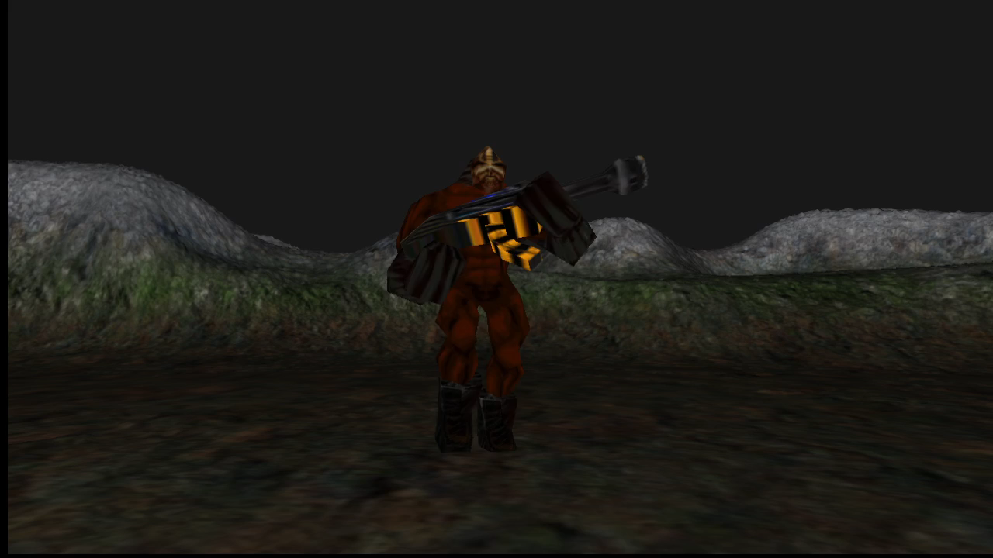
Animations
Initially intended to do Skeletal Animation via FBX models
Decided to try Keyframe Animation with MD2 Models
Dylan played some Quake 2 to try and learn how MD2 Models work
Wander – Walk
Chase – Run
Flee – Run
Attack – Shoot
Alert – Point
Death – Fallback/Dead

Slide 10

DEMO TIME

Slide 11
Issues Encountered
Lack of information and resources on MD2 models
Overall workload
Lack of confidence in MVC Design
Unsure of how to best implement scripting (especially with AI)
Plenty of bugs

Slide 12
Lessons Learnt
“It's never as good as it seems and it's never as bad as it seems.”
We learnt that we work well as a team
Designing a Game Engine isn’t easy, but its rewarding

Slide 13


Question Time!

